Slide 1
1. Read Json file from Python
2. Parse the file into 2 lists (anchors, tags)
3. Create instances of anchors and tags
ArrayList <Anchor> anchors
ArrayList <Tag> tags
Anchors have
ID, double X, Y, Z
Tags have
Int ID, String usage (worker?, equipmet type 1)

Slide 2
Overview of GUI
Project properties:
Name, Date, 2D/3D, Description, Name of Config File, etc.
New Project
Save Project
Load Project
Items
Construction Site
Anchor
Drag and drop, then assign XY, show here

Slide 3
Save sensor list
A list of anchors
Anchor 1: IP
Anchor 2: IP
A list of tags
Tag 1: IP
Tag 2: IP
….
We have 10 anchors, 20 tags
Load this text file to a project

Slide 4
Overview of GUI
Project properties:
Name, Date, 2D/3D, Description, Name of Config File, etc.
New Project
Save Project
Load Project
Items
Construction Site
Anchor
Sensors
Tag
Equipment
Site Objects
Worker
Road
Site Environment
Unsafe Area
Other Area
Safety Rules

Slide 5
Overview of GUI
New Project
Save Project
Load Project
Items
Construction Site
1. Drag-Drop
Anchor
2. (Double )Click to edit
Sensors
Tag
Properties:
ID (select from Anchor list)
Location 2D
Location 3D
Equipment
Site Objects
Worker
Road
Site Environment
Unsafe Area
Other Area
Safety Rules

Slide 6
Overview of GUI
New Project
Save Project
Load Project
Items
Construction Site
Anchor
Sensors
2. Default Box polygon appears
Tag
1. Drag-Drop
2. (Double )Click to edit
Equipment
Properties:
Information will be given
Site Objects
Worker
Road
Site Environment
Unsafe Area
Other Area
Safety Rules

Slide 7
Properties of Equipment (three types)
Tag
Tag ID: select from tag list
Click to specify direction (Shubham will help)
D
Unsafe area
Forward
Width
C
Length
More information will be given later
A
B

Slide 8
Overview of GUI
New Project
Save Project
Load Project
Items
Construction Site
Anchor
Sensors
Tag
1. Drag-Drop
2. (Double )Click to edit
Equipment
Properties:
Worker type
Worker name
Tag ID (select from tag list)
Site Objects
Worker
Road
Site Environment
Unsafe Area
Other Area
Safety Rules

Slide 9
Overview of GUI
New Project
Save Project
Load Project
Items
Construction Site
Anchor
Sensors
Tag
Read CAD from Python
or CAD-to-XML, read XML
Equipment
Site Objects
Worker
1. Drag-Drop
Click points of a polygon
- Area Name
- Type of hazards
- Buffer size
Road
Site Environment
Unsafe Area
Other Area
Safety Rules

Slide 10
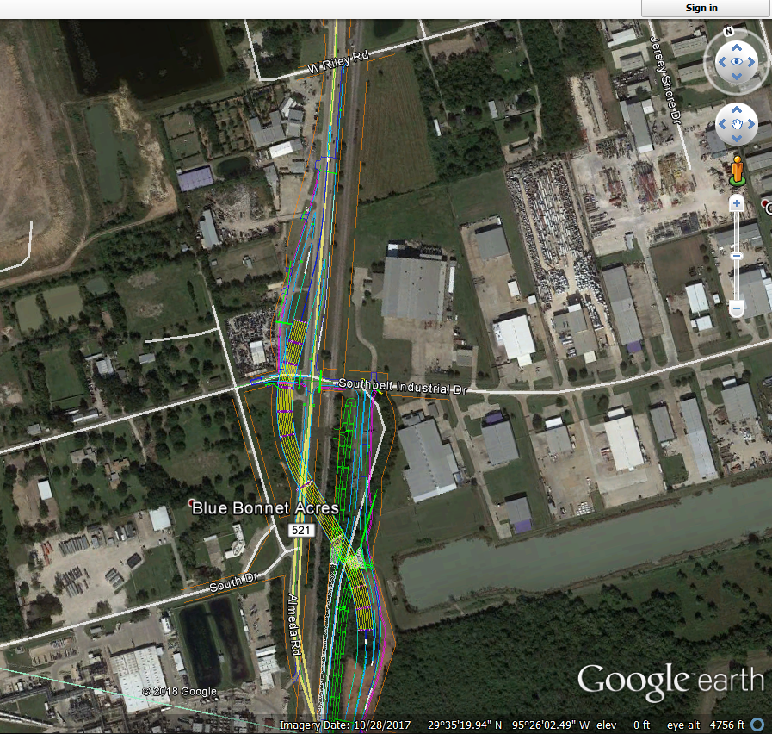

Slide 11
Overview of GUI
New Project
Save Project
Load Project
Items
Construction Site
Options:
Show current point, all trajectory, or latest trajectory
Show worker, equipment operator faces or not
Anchor
Show current locations, or trajectories
Show in different color if in unsafe areas
Show who is unsafe, why, timestamp of safety, etc.
Tag
Equipment
Worker
Road
Unsafe Area
Other Area
Safety Rules

Slide 13
Note on GUI

Slide 14
Generate a configuration file
Anchor locations
Tag utilization types (worker, vehicle-front, vehicle-back, vehicle-left, etc.)
Types of zones
Vehicles, unsafe areas around vehicles (buffered spaces)
Static unsafe zones
Work areas
Traffic

Slide 15
Creating a project

Slide 16
Creating site objects
Drag-drop-adjust

Slide 17
Adding sensor information

Slide 18
Adjusting safety rules

